Slide 1

Machine Learning Model for Ad Click Prediction
By: Reeva Bhatkal

Slide 2
Business Problem
A marketing agency wants to understand the features of a user who are likely to click on an advertisement. Using a machine learning algorithm we will develop a prediction model, that predicts if a particular user will click on an advertisement or not.
The objective is to predict who is most likely click on the ad and guide the marketing team to target the appropriate users to maximize profitability.
The success criteria of the project will be a good recommendation of machine learning model that can accurately predict whether a user will click on an ad based on the features of that user

Slide 3
Understanding the Data
Our data contains demographics about users and whether that user clicked on an ad or not.
Data Dictionary:
Variable Name | Description
Daily Time Spent on a Site | Time spent by the user on a site in minutes
Age | Customer's age in terms of years
Area Income | Average income of geographical area of consumer
Daily Internet Usage | Average minutes in a day consumer is on the internet
Ad Topic Line | Headline of the advertisement
City | City of the consumer
Male | Whether or not a consumer was male
Country | Country of the consumer
Timestamp | Time at which user clicked on an Ad or the closed window
Clicked on Ad | 0 or 1 is indicated clicking on an Ad
Daily Time Spent on a Site | Time spent by the user on a site in minutes
Source for data-Kaggle: https://www.kaggle.com/datasets/gabrielsantello/advertisement-click-on-ad/code

Slide 4
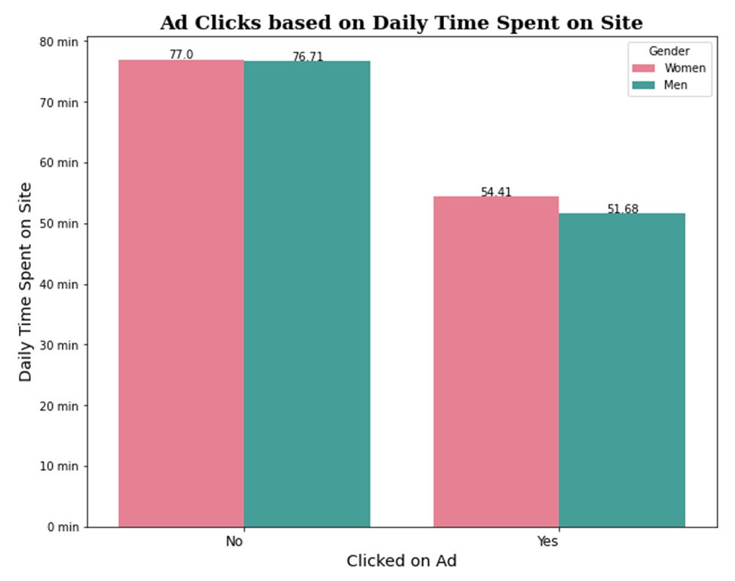
Observation 1: Ad Clicks based on Daily Time Spent on Site
Through our initial analysis, we can observe that even though people are spending more time on the internet they are not clicking on Ads
An increase in 'Daily Time Spent on the Site’ does not imply that the person is more likely to click on Ads
We see that for people who spend around 55 mins on the site daily are more likely to click on Ads.
Women tend to spend more time on the site than Men
Women also tend to click on Ads slightly more than Men

Slide 5
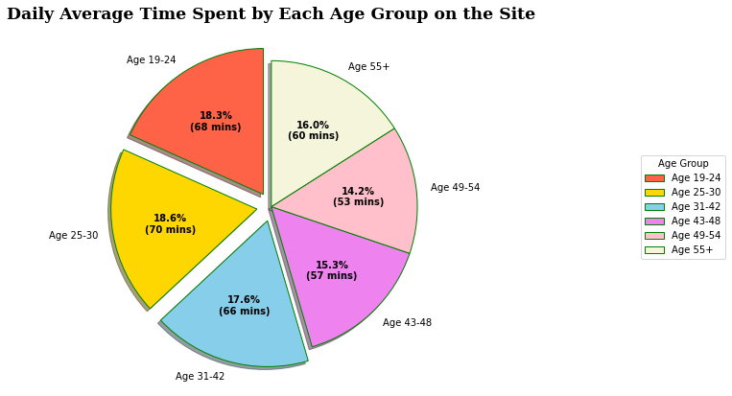
Observation 2: Daily Average Time Spent by Each Age Group on the site
We see that People in the Age group 19-24 , 25-30 and 31-42, have a higher daily average time spent on the site
People in the Age group 43-48 , 49-54 and 55+ , have a lower daily average time spent on the site compared to other groups
Since we know from our previous observation that time spent does not reflect Ads clicked, lets us further analyze the percentage of people in each group who are likely to click on Ads as these are our target customers.

Slide 6
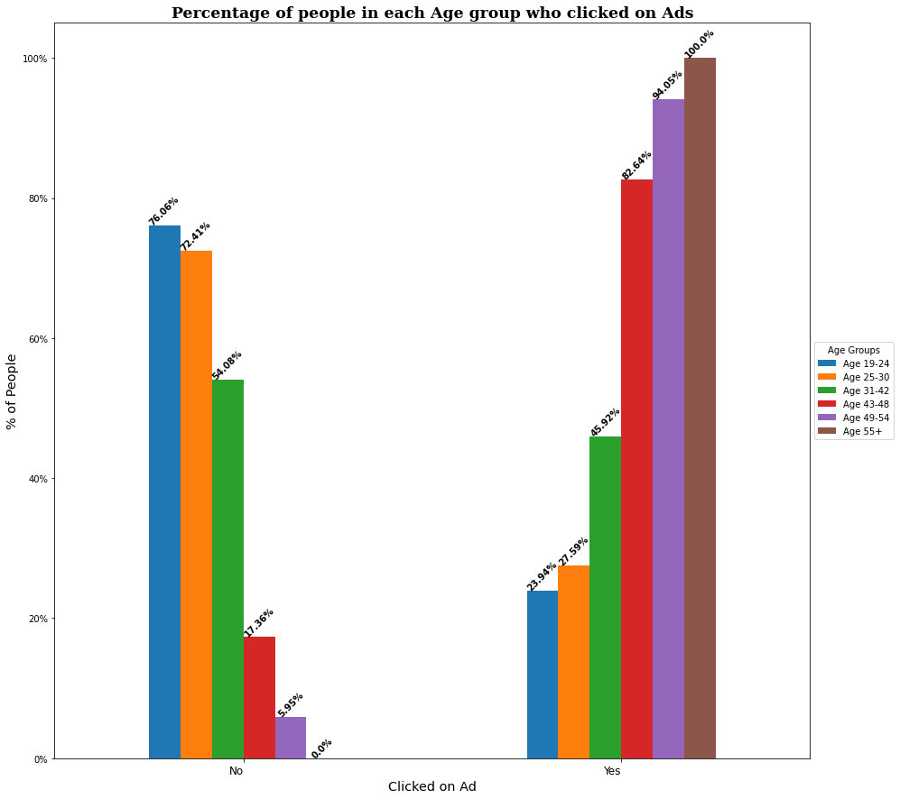
Observation 2.1: Percentage of people in each Age Group who clicked on Ads
1) We can observe that people above the age of 43+ tend to click on Ads more
* 100 % of people who belong to the Age group 55+ click on Ads
* 94 % of people who belong to the Age group 49-54 click on Ads
* 82 % of people who belong to the Age group 43-49 click on Ads
2) People below the age of 43 spend longer time on the site but do not tend to click on Ads
* 45 % of people who belong to the Age group 31-42 click on Ads
* Only 27 % of people who belong to the Age group 25-30 click on Ads
* 23 % of people who belong to the Age group 19-24 click on Ads

Slide 7
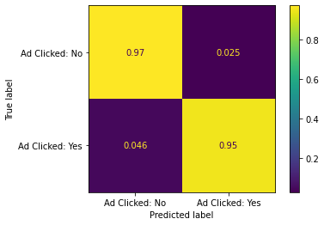
Results: Logistic Regression Model
After evaluating different modelling techniques, we recommend using the Logistic Regression Model. This works best for predicting if the user will click on an Ad.
Our model correctly predicts 95% of users that have been targeted and clicked on the Ad. (This metric is very important as for every targeted user who clicks on the Ad, it generates revenue for the company)
Our model also has a low error rate of 2.5% . These are identified users have been targeted but did not click on the Ad. (This metric is also important, as this could result in loss of revenue of the company)

Slide 8
Recommendation:
Since the dataset has location and timestamp data, we can possibly create more powerful models using these features to understand user behavior based on location and time of the day.
We can further investigate if search keywords, or ads may be relevant during certain periods of the day. Are ads less likely to get a click during the morning versus the afternoon or on weekends or weekdays?
Through our initial analysis we found that people who click on ads tend to spend a lot less time online. We should further investigate the reasoning behind this and find out who these people are and does spending more time online make people immune to ads.

Slide 9

Conclusion
This analysis is performed on limited data. If good amount of data is available there is scope to produce better models.
With digital marketing dominating over traditional marketing, a lot of companies prefer to advertise their products on the web. This model of ad click prediction will allow companies to maximize their revenue while offering targeted marketing to customers

Slide 10
Any Questions?

Slide 11
Thank You!

